Slide 1
New Controls for the BlackJack Form
The menu Strip and the Message Box

Slide 2
Menu Strip Control
Offers advantage of taking up minimal space
Open the Menu and Toolbars section of the Toolbox
Drag and drop MenuStrip object from toolbox to your form
Icon representing MenuStrip is placed in Component Tray
Select MenuStrip object to set its properties
To add the text for a menu option, select the MenuStrip icon and then click in the upper-left corner of the form

Slide 3
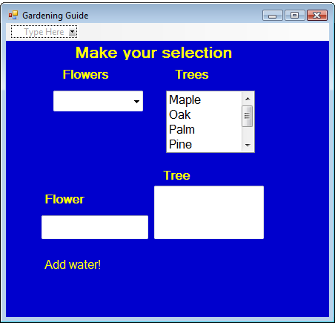
Adding Menus
Drag MenuStrip control to form, then click here to display Menu structure
First step to creating a menu

Slide 4
Wire Methods to Menu Option Event
FIRST set the Name property for each menu option.
The menu Click event is registered by double-clicking on the Menu option, “Rules of the Game”
When the menu option is clicked, the event triggers, happens, or is fired.
In the event handler, pop up the Message Box with the Rules of the Game.

Slide 5
The Message Box Class
Used to display error messages, ok buttons, and get simple messages from the user.
You cannot create a new instance of the MessageBox class.
You will use the static method, Show().
To display a message box, call the static method MessageBox::Show( );

Slide 6
Example of Message Box
Simply place a .NET string or a string literal into the arguments of the Message Box
MessageBox::Show(“ BlackJack is fun!”);
OR
String ^ mess = “ BlackJack is fun!”;
MessageBox::Show(mess);

